Slide 1
E V E N T
M A N A G E M E N T
A D E C I S I O N M A K I N G S C E N A R I O
AN INITIATIVE BY
THE EDGE HOTEL SCHOOL

Slide 2
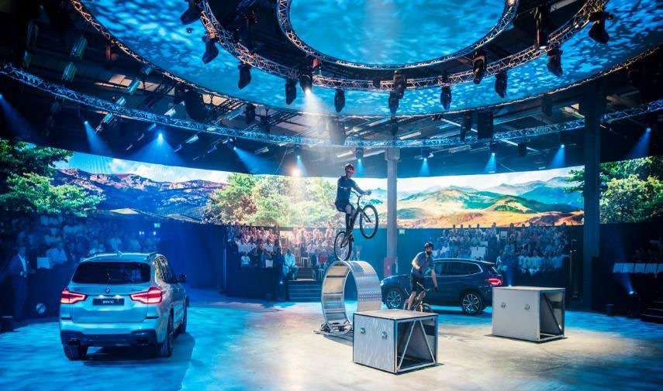
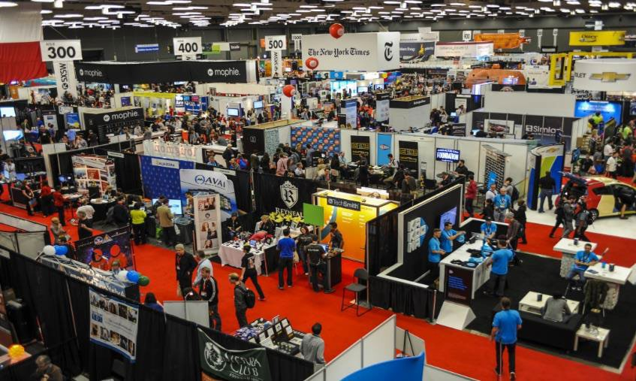
EVENT MANAGEMENT
Event managers plan and organise promotional, business and social events. They're responsible for running a range of events, ensuring the target audience is engaged and the message of the event is marketed properly.
As an event manager, you'll organise conferences, seminars and exhibitions, as well as parties and corporate incentive trips. You'll manage the whole process from the planning stage, right through to running the event and carrying out the post-event evaluation. The role is primarily hands-on and often involves working as part of a team.
www.prospects.ac.uk/job-profiles/hotel-manager

Slide 3
THE BRIEF
In your team you need to develop a plan for a charity concert and put together an event proposal.
You will need to identify which charity this concert should support and develop a proposal for that chosen charity.
You will need to present you ideas to charity at the end of the activity.

Slide 4
WHAT IS AN EVENT PROPOSAL
The event proposal is a creative document presented to the client to show the following information:
?
WHAT
You have to define type of event you are planning
TEAM
You have to define the job titles of everyone in the team
CONCEPT
You have to detail what the event will look like
LOCATION
You have to pick a location and find a venue
£
MARKETING
You have to create a marketing strategy for your event
COSTS
You have to develop a budget for the event that includes expense and profit
RATIONALE
You have to be able to discuss the reasoning behind your event ideas

Slide 5
YOU NEED TO CONSIDER
When creating your event proposal you will need to make sure you have considered a lot of different elements to make sure your event stands out.

Slide 6
ENTERTAINMENT
Who is your band or artist? Will there be any other type of entertainment arranged for the event?

Slide 7
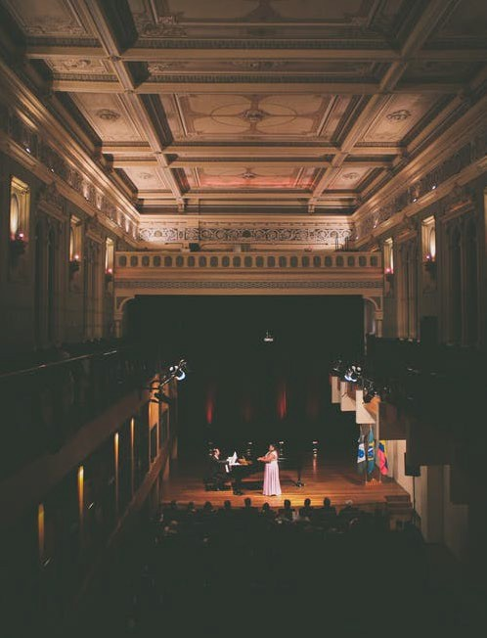
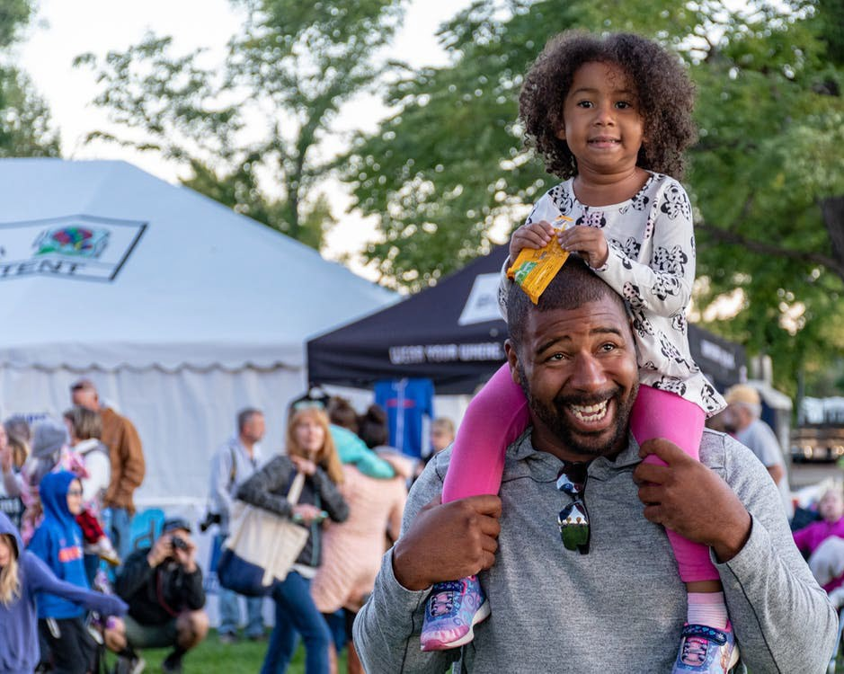
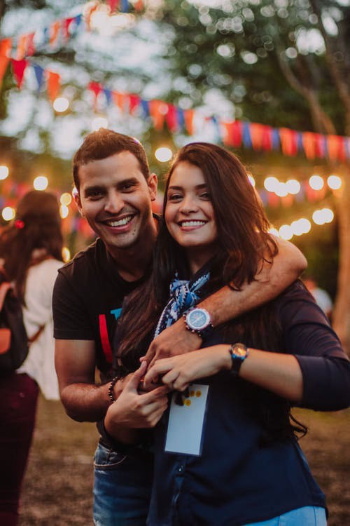
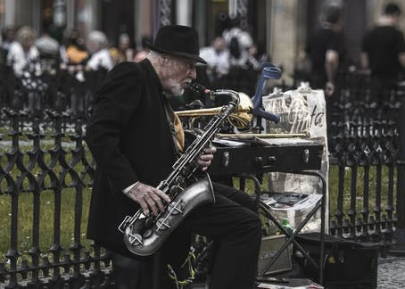
TARGET MARKET
Who are your guests? What kind of experience are they looking for?

Slide 8
TICKET PRICES
How much should you charge your guests for their tickets (remember you want to make a profit).

Slide 9
COSTS
How much will the venue, catering, staff, marketing and so on cost your team? Can you get anything gifted or free? Are there any sponsors who can support the event?

Slide 10
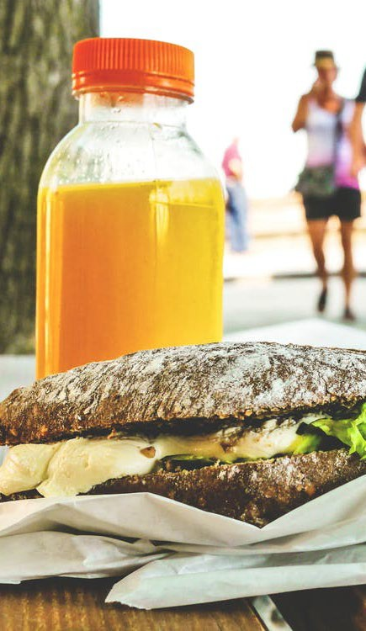
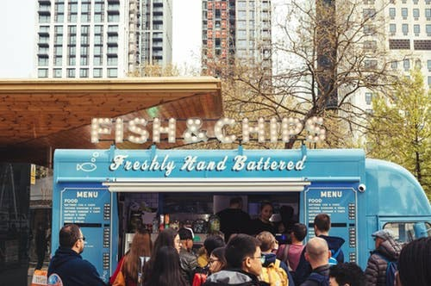
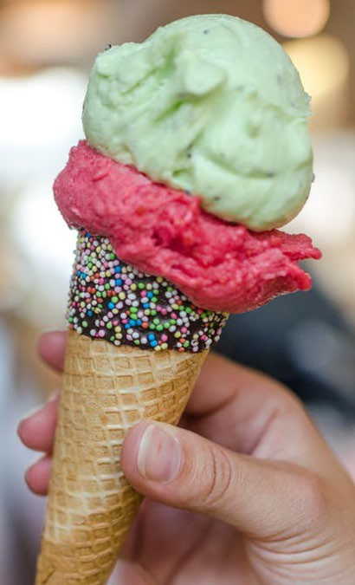
FOOD AND DRINK
What type of food outlets will be available? Does it suit the event and target market? How much do you need to provide to cover the guests.

Slide 11
LICENSE OR PERMISSIONS
You need to ensure you are running a legal event and should consider any licences or permissions you may need
i.e alcohol etc

Slide 12
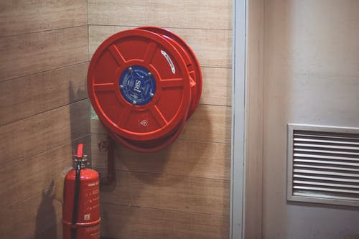
HEALTH AND SAFETY
What measures will be checked to ensure your event meets health and safety guidelines.

Slide 13
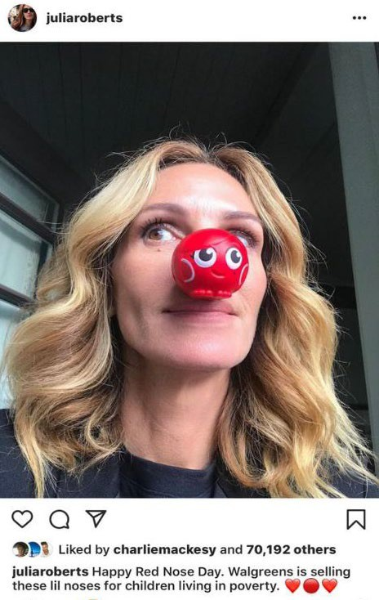
MARKETING
AND PROMOTION
How will you raise awareness about the event? What tools and ideas can you use to make sure you sell your tickets?

Slide 14
DONATIONS
How much funds will you be able to donate to the charity?

Slide 15
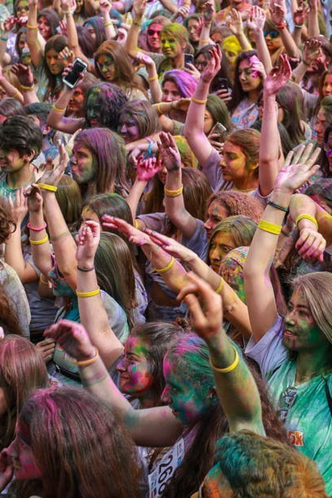
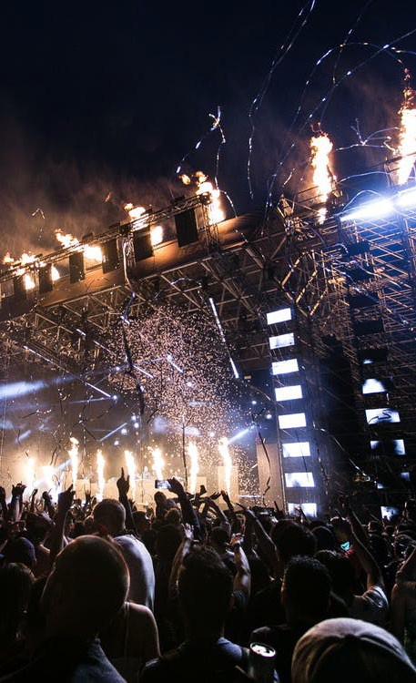
THANK YOU FOR PLAYING EVENT MANAGEMENT!
For more information on hospitality careers and education, check out the Edge Hotel School

