Slide 1
HOTEL MANAGEMENT
A REAL WORLD SCENARIO
AN INITIATIVE BY
THE EDGE HOTEL SCHOOL

Slide 2
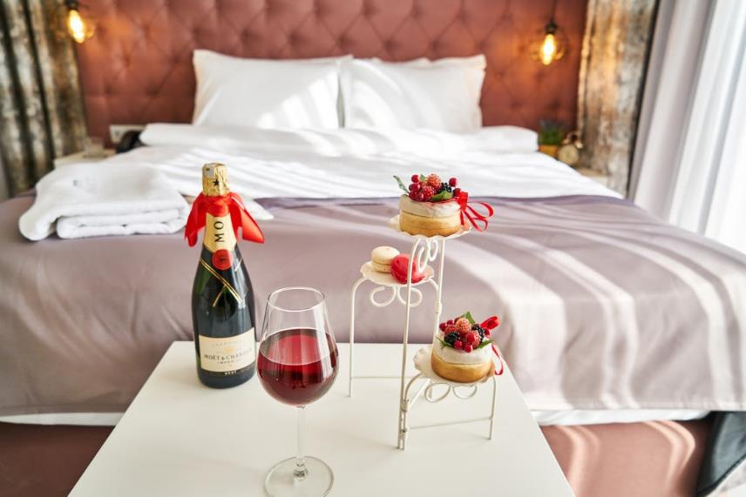
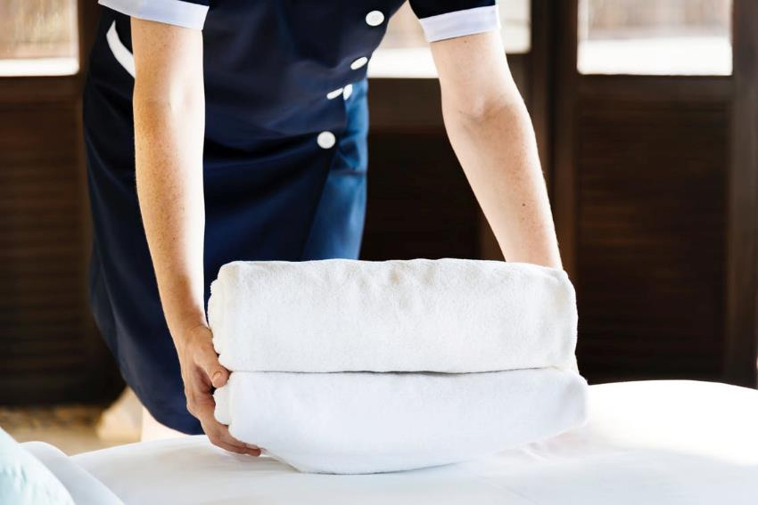
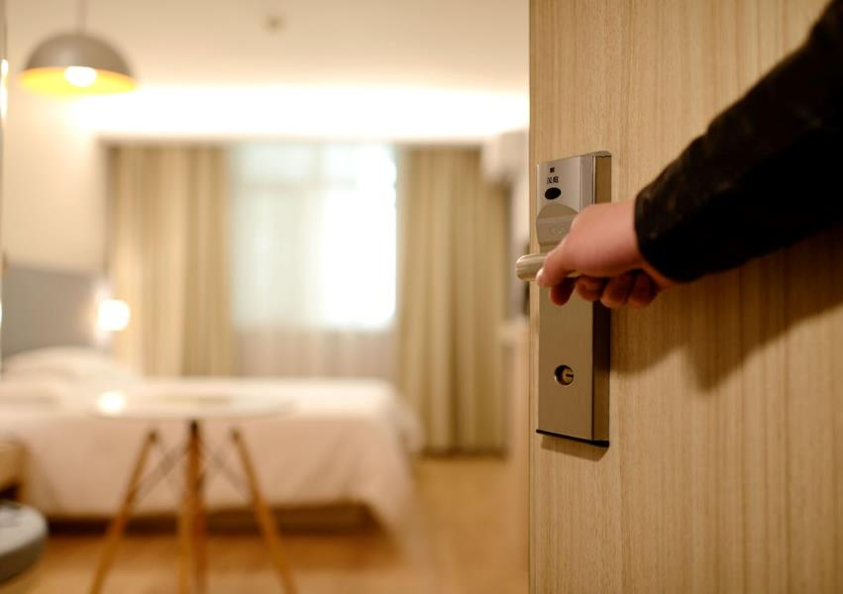
HOTEL MANAGEMENT
In the role of hotel manager, you'll be responsible for the day-to-day management of a hotel and its staff. You'll also be commercially accountable for budgeting and financial management and will need to plan, organise and direct all hotel services, including front-of-house (reception, concierge, and reservations), food and beverage operations and housekeeping.
www.prospects.ac.uk/job-profiles/hotel-manager

Slide 3
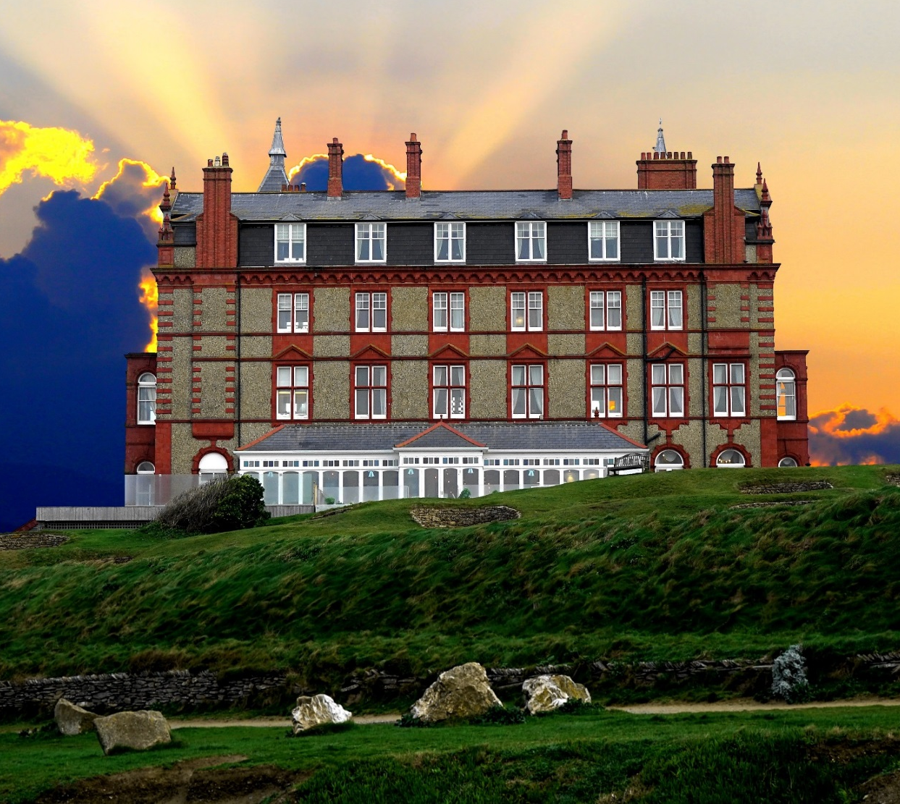
CONGRATULATIONS!
You have been successful in your application for the position of Hotel Manager of the Calamity Cliffside Hotel.
By the way, there are one or two issues with the hotel that we forgot to mention at your interview...

Slide 4
INFORMATION
At your very first meeting of the day, you are shocked to hear the hotel’s Bank Manager give you just 8 months to get the hotel to make a profit or he will shut you down.
The Owner informs you that the hotel hasn’t made any money for 15 years and needs a huge shake up but doesn’t know what to do. Unfortunately, the Owner leaves the hotel immediately to run his other businesses, hands you the keys and asks you to send on monthly results; basically, he is leaving it all up to you.
You decide to work within each department during your first day and make a list of some of the things that need fixing urgently. The list is 8 items long for each department and you must now decide what needs to be done first.
Your team must keep the following in mind when changing the hotel:
£
TIMELINE
COSTS
CLEAR
You only have 8 months to make profit so you need to consider ideas that will have quick results
You may need to spend money in order to get the hotel standard up; but you do have a limited budget
You must write down full and clear solutions so your hotel team are able to enact your visions

Slide 5
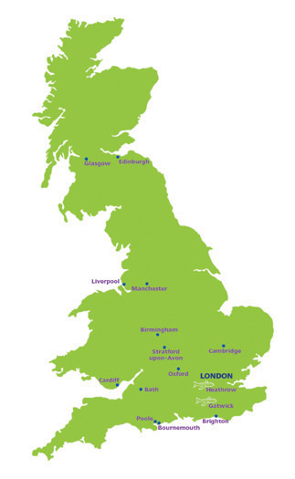
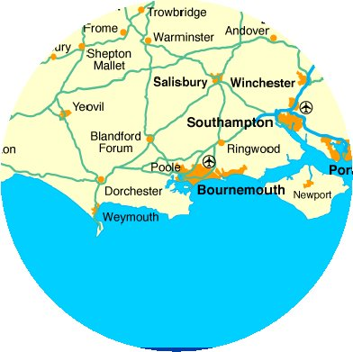
ABOUT THE HOTEL
The hotel is positioned on the clifftops of Bournemouth, a coastal city in Dorset.

Slide 6
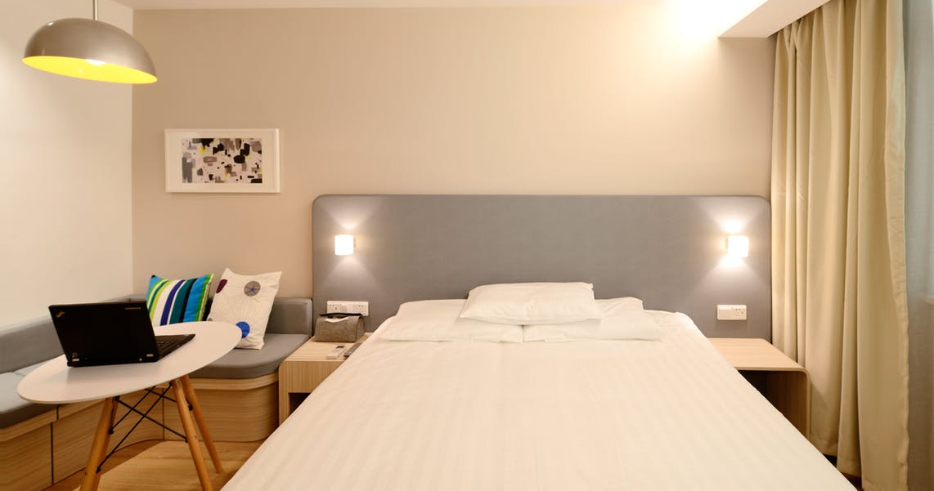
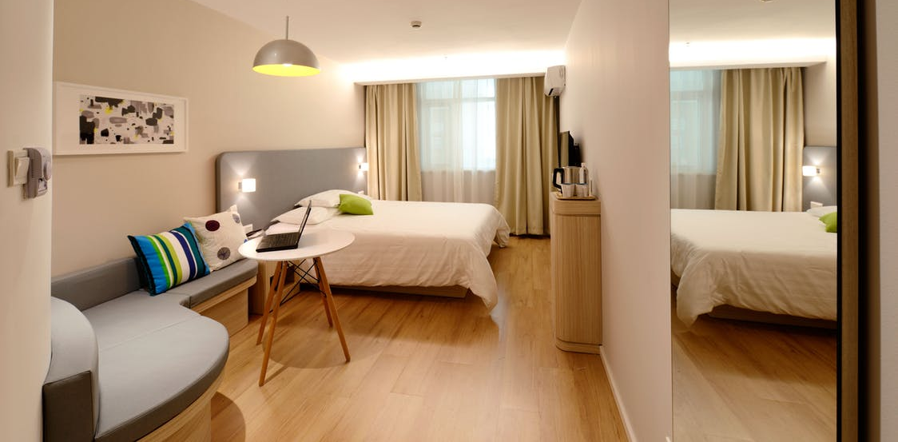
ROOMS
There are 100 bedrooms (all of good standard):
20 Singles
40 Doubles
40 Twins

Slide 7
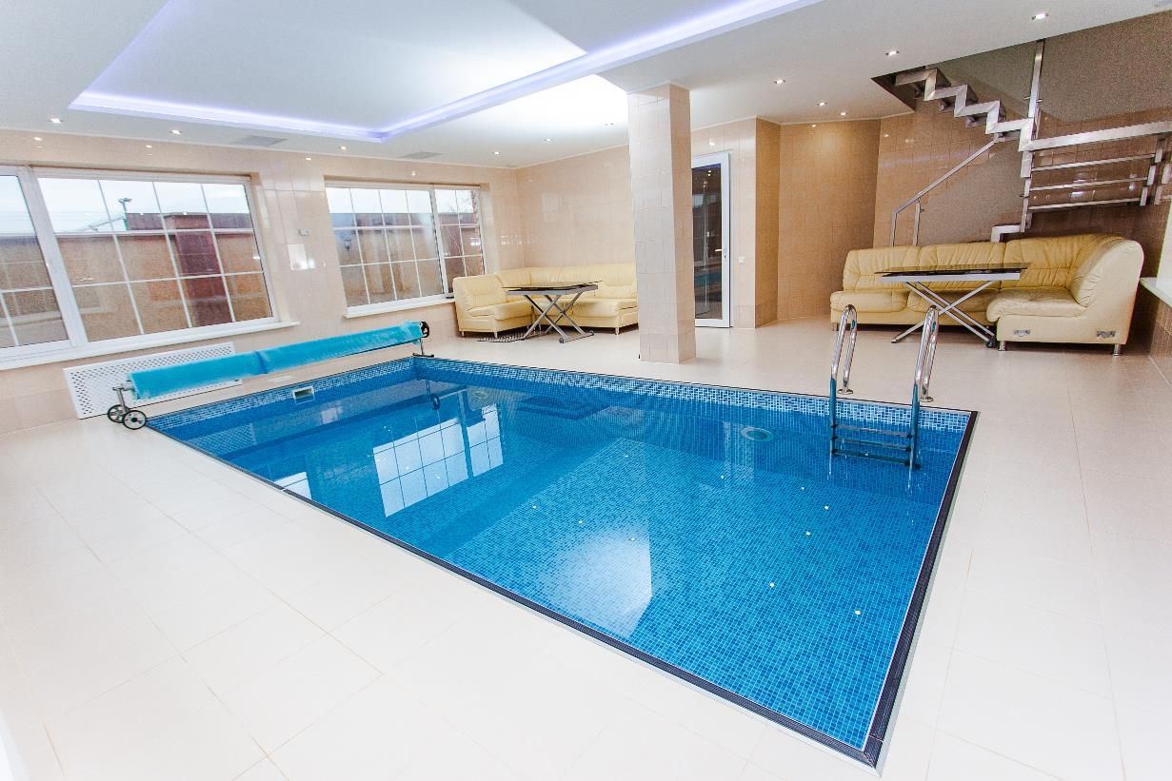
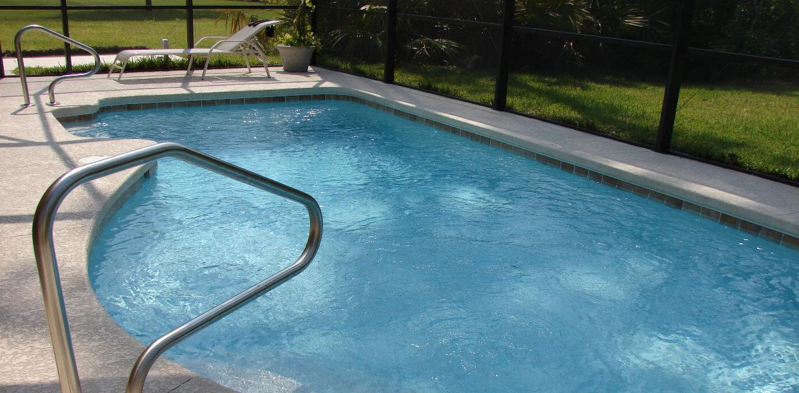
FACILTIES
There is an indoor and outdoor pool at your hotel, as well as access to the public beach.

Slide 8
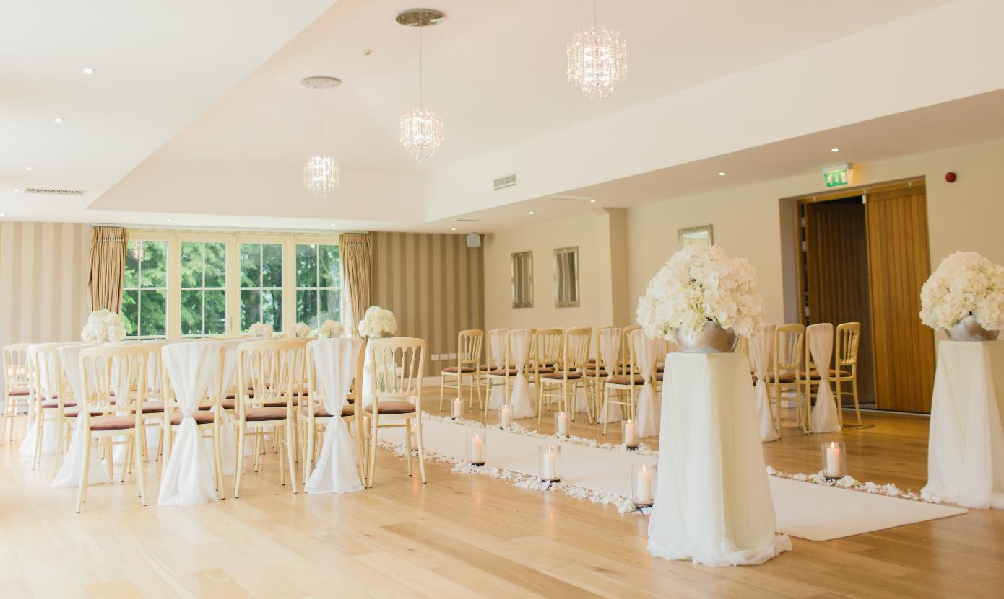
EVENTS
The hotel has a function room that accommodates
up to 100 guests.

Slide 9
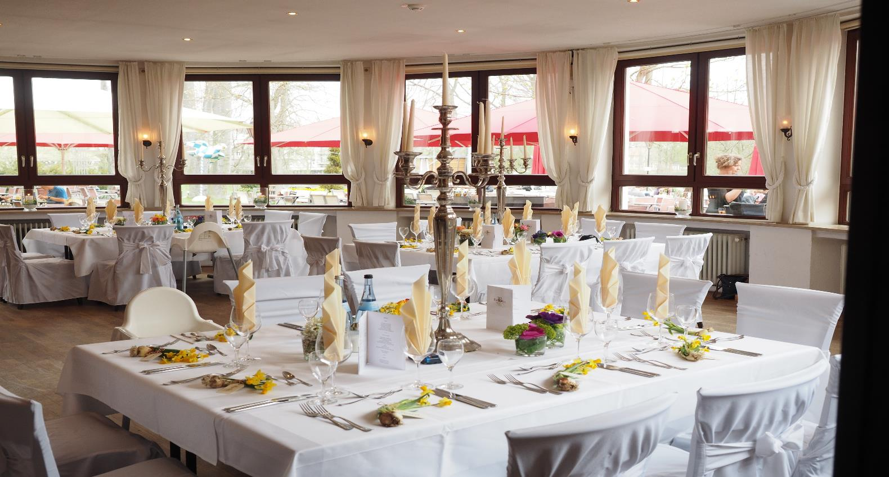
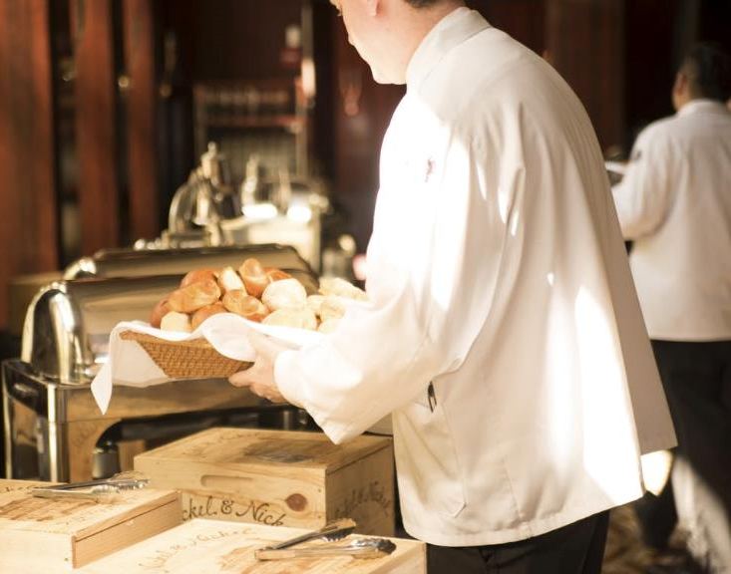
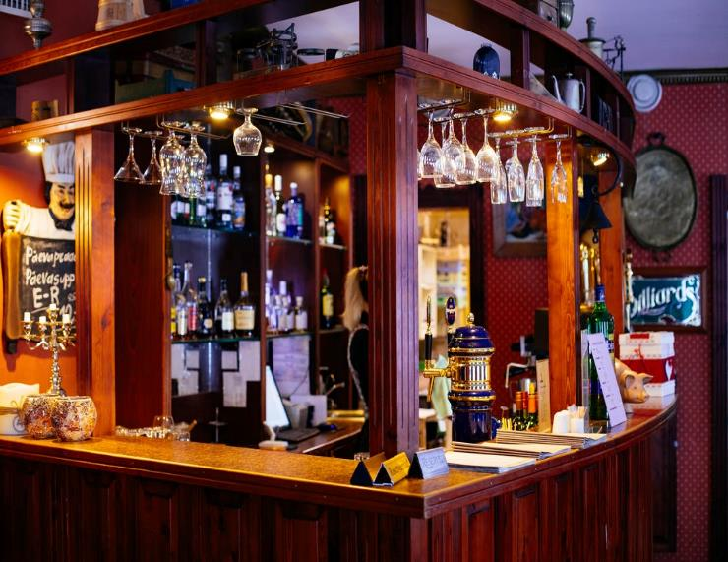
FOOD AND DRINK
The hotel has both a bar and restaurant that
covers 100 guests.
.

Slide 10
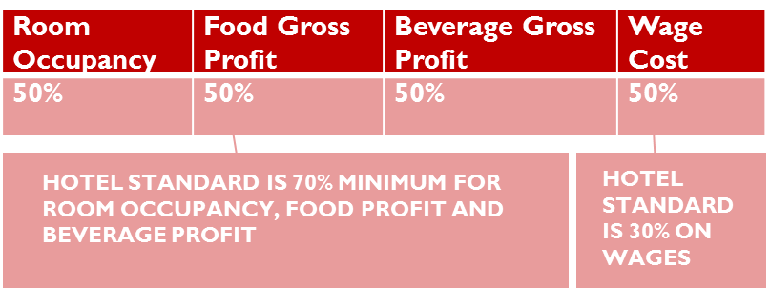
ACCOUNTS
Under the previous owners the hotel used to make £300k / year but since the current owners took over it hasn’t made a profit for over 15 years and has built up debts of over £2million.
The bank will allow you a £100,000 overdraft to turn the hotel around but has given you 8 months to make a monthly profit or they will call in the receivers.

Slide 11
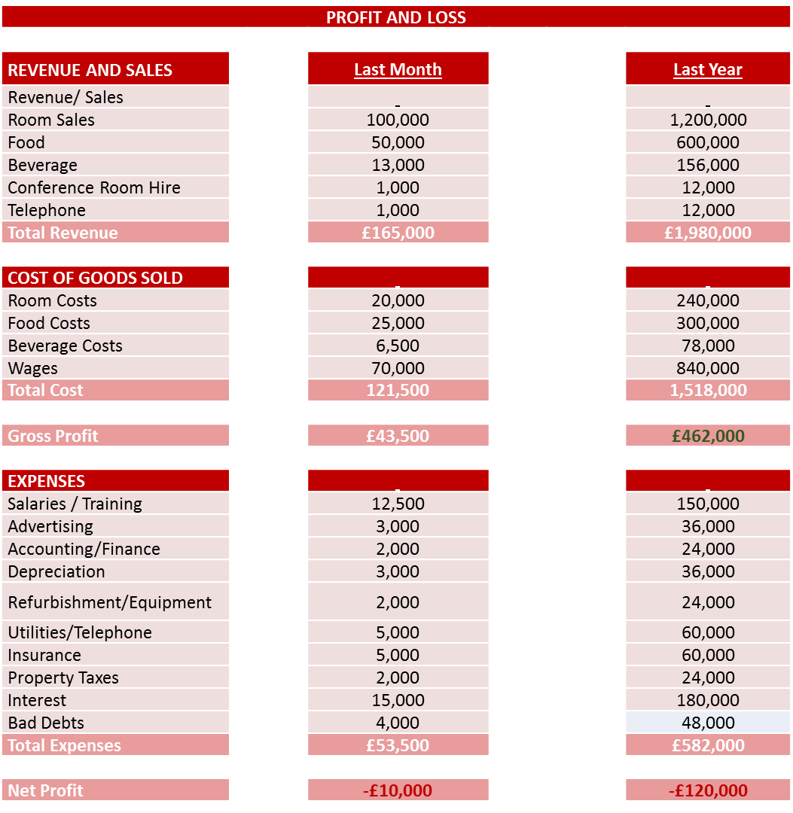
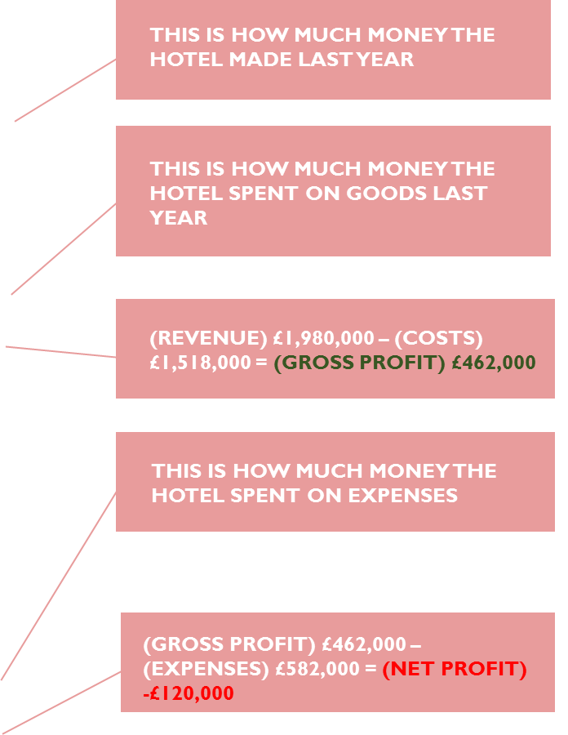
ACCOUNTS

Slide 12
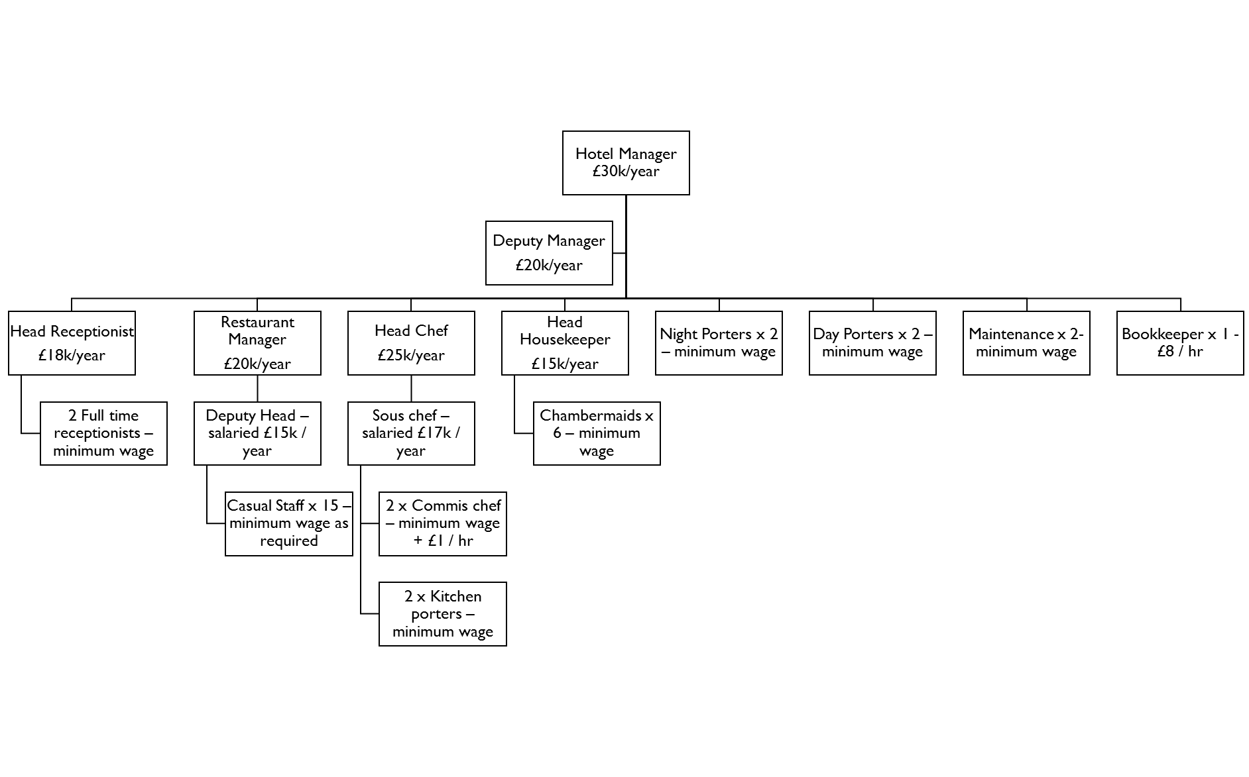
STAFFING
YOU
This is a flow chart of all the staff within your hotel, from senior management to entry level staff members.
.

Slide 13
ISSUE:
DEPUTY MANAGER
James is the Deputy Manager and is 24 years old. He has been at hotel 2 years, straight from University. Good with customers and popular with staff, but struggles on a daily basis as he has no operational experience.
He cannot cover reception as he doesn’t know how to use the computers, he has never worked in a restaurant or kitchen and doesn’t know anything about housekeeping.
Despite being in the hotel for 2 years he has made no attempt to learn about the departments as he believes a degree is enough to be able to manage a hotel. As a result when the hotel is busy he panics and is unable to help anywhere and gets very stressed. In the past he has sworn at staff and even a customer when put under pressure.

Slide 14
THE CHALLENGE
After your day in the office you have listed eight managerial issues that you believe are lowering the hotels profits.
Your job is to decide what order your team wants to tackle the issues; the order you chose is important so really consider what will be the best issue to start with to begin making money.
The activity leader has sheets with more information about each of the eight issues which they will hand to your team when requested. Each issue tells you more about what is going wrong, you will need to write down your solutions on the provided sheet.
The winner is the team that makes the most profit over the eight month period.
The eight issues are:
£
MORALE
MENU
EVENTS
SALES
MARKETING
PERSONAL
DEVELOPMENT
CUSTOMER
CARE
UTLITIES
SUPPLIES

Slide 15
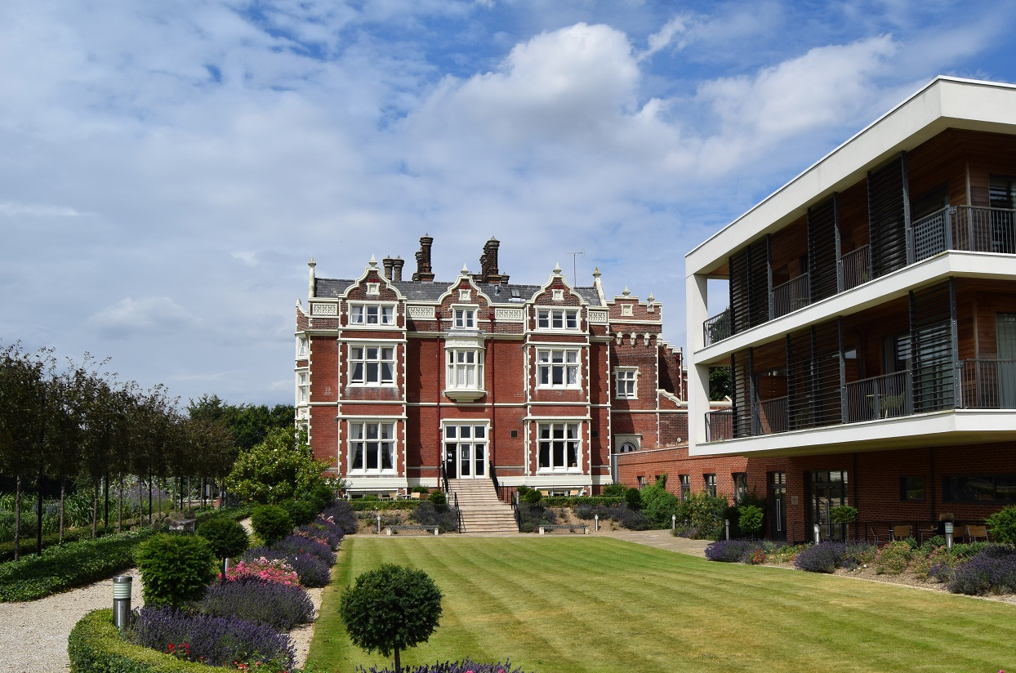
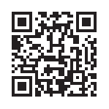
THANK YOU FOR PLAYING
EVENT MANAGEMENT!
For more information on hospitality careers and education, check out the Edge Hotel School

