Slide 1

Accidental Dwelling Fires:
Evaluated
University of Essex ImpacTeam, presented by Catalyst
Evaluating your impact in the community.

Slide 2
Evaluations: Why Do We Need Them?
Lack of suitable baselines of programme success;
Insufficient data on input, unit input and performance;
Difficulties in demonstrating links between input, performance and improved frontline services;
Insufficient quality control prior to external reporting;
Lack of transparency over arms-length bodies’ reporting processes to trace progress.
---------The UK National Audit Office (NAO)

Slide 3
Evaluations: Common Concerns
Evaluation will divert resources away from the programme.
  Costs:
    Typically 10%-20% of overall programme budget
  Benefits
    Streamline resources
    Focus on “what works” for programme participants
    Improve outcomes
Evaluation will be too complicated.
  Can be simple and straightforward.
  Must be appropriate to a programme's service model, objectives, and resources.

Slide 4
Evaluations: Common Concerns
Evaluation will be an additional burden on staff.
  Can be incorporated into ongoing programme management activities.
Evaluation will produce negative results.
  Finding out “what does not work” allows resources to be allocated toward “what does work.” 
Evaluation is just another form of programme monitoring.
  programme monitoring assesses whether a programme is in compliance with specified performance standards (e.g., number of participants served).
  Evaluation assesses whether expected outcomes were achieved.

Slide 5
Evaluation in the Public Sector
Find out ‘what works’ and ‘what does not work’.
Showcase programme effectiveness to the community and funders.
Inform decisions about programme refinements and resource allocation.
Improve frontline practice with participants.
Improve staff morale.
Increase accountability and transparency.
Increase a programme's capacity to conduct a critical self- assessment and plan for the future.
Notes:
A programme evaluation can find out “what works” and “what does not work”: A process or outcome evaluation enables programme managers to answer basic questions about a programme's effectiveness, including:  Are participants benefiting from programme services?  Are recruitment strategies working?  Do staff have the necessary skills and training to deliver services?  Are participants satisfied with the program?  Are some sub-groups benefiting, but not others? Knowing “what works” helps programme managers to focus resources on the essential components of the programme model that benefit participants and volunteers; knowing “what does not work” allows programme managers to improve and strengthen their service delivery models. Not knowing what is working may waste valuable time and resources.
A programme evaluation can showcase the effectiveness of a programme to the community and funders: Evaluation findings can demonstrate to a community and to funders that a programme is worthwhile. Sharing findings within the community can serve as a good outreach tool for attracting collaborative partners, recruiting participants and volunteers, and building trust with families and community members. Also, funders often require that a programme evaluation be conducted when they agree to fund a program, and some funders will not fund, or re-fund, a programme until an evaluation has been conducted and outcomes have been demonstrated.
A programme evaluation can improve staff’s frontline practice with participants: Improving how frontline staff members deliver services to children and youth will increase the likelihood that a programme will achieve positive outcomes with programme participants. Conducting an evaluation of a programme can allow a programme manager to systematically assess staff’s performance, and figure out where staff members are succeeding and where they may need more support or training. An evaluation can also provide staff with opportunities to discuss the challenges they face and offer potential solutions. Evaluation questions may include:  Do staff have the necessary skills to work effectively with programme participants?  What types of additional training would benefit staff?  Are staff receiving the ongoing coaching and mentoring necessary to do their work? Do staff have the necessary supports to function effectively?
A programme evaluation can increase a programme's capacity to conduct a critical self- assessment and plan for the future: Conducting an evaluation either internally or with an outside evaluator will build an organization’s capacity to conduct critical self-assessments, including conducting staff and programme needs assessments, measuring staff performance, and assessing whether programme objectives have been met. This will strengthen programme operations and, consequently, improve outcomes for those served. Knowing how and for whom the programme is effective and ways services can be strengthened are essential building blocks for an organization’s strategic plan. Having the goal and the capacity for self-assessment allows for ongoing reflection and planning and helps create a continuous learning organization.

Slide 6
Cooperation: Key to evaluation success
Strong desire to assess programme impact.
  Both the ECFRS and UoE want to know how to improve people’s lives.
Communication is open, honest, respectful and effective.
  Regular exchange of ideas, concerns, and feedback on evaluation process and results.
Outstanding Problem-solving ability
  Understanding of organisational needs, flexibility, adaptability.

Slide 7
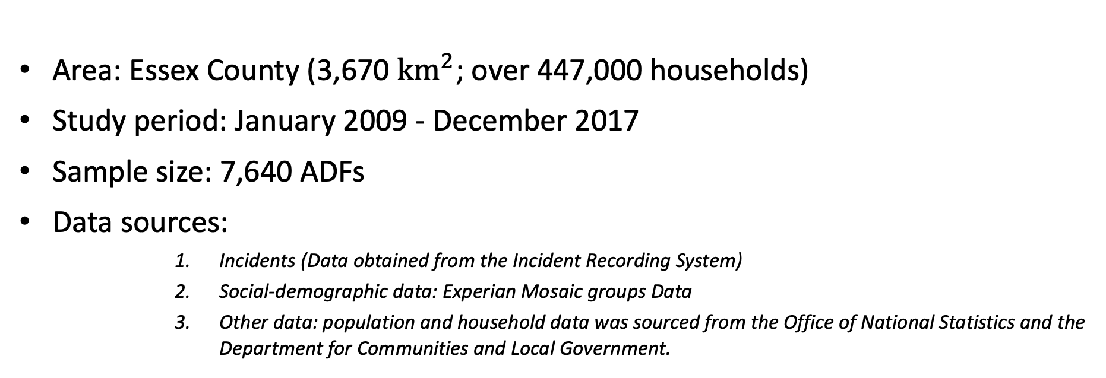
Accidental Dwelling Fires
Area: Essex County (3,670 ${km}^{2}$; over 447,000 households)
Study period: January 2009 - December 2017
Sample size: 7,640 ADFs
Data sources:
      Incidents (Data obtained from the Incident Recording System)
      Social-demographic data: Experian Mosaic groups Data
      Other data: population and household data was sourced from the Office of National Statistics and the Department for Communities and Local Government.

Slide 8
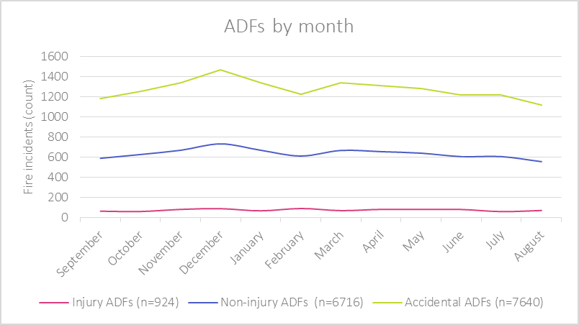

Slide 12
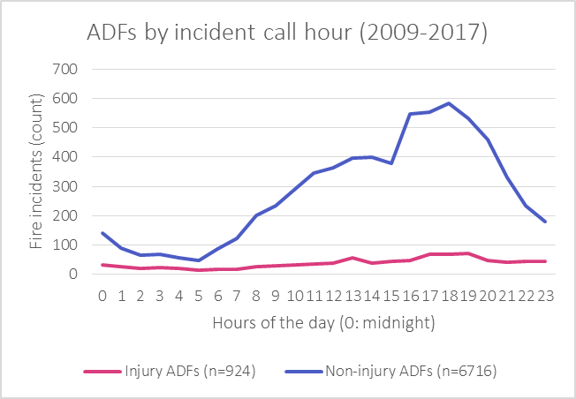

Slide 15
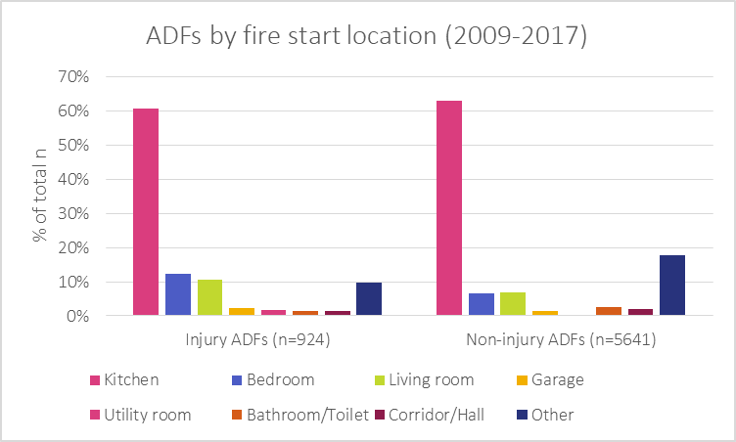

Slide 17
FINDINGS: cause

Slide 21
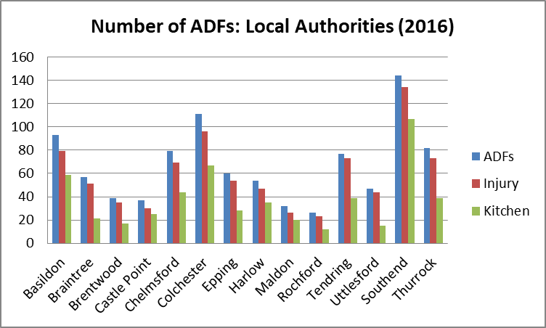
FINDINGS: LOcal authority

Slide 22
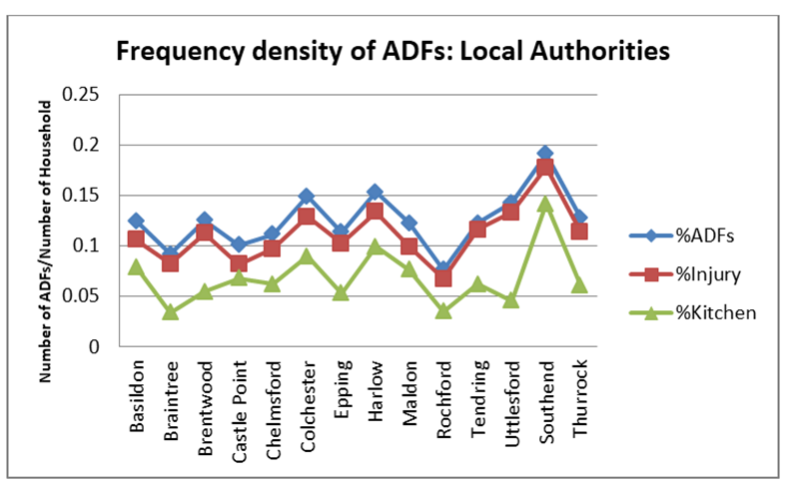
FINDINGS: LOcal authority

Slide 26
 |  | Model 1 | Model 2 | Model 3
ADFs occurring in Essex in 2016: |  | (all ADFs) | (kitchen ADFs) | (smoking ADFs)
Group 1 | Households on low incomes living in social housing (K51, N61, O68, O69) | 1.281*** | 1.380*** | 1.332***
Group 2 | Transient singles (G33, I43) | 1.072*** | 0.908*** | 1.113**
Group 3 | Poorer older householders living in social housing (M) | 0.877** | 0.831** | 0.930**
Group 4 | Couples and young singles in modern starter homes (H36, H37) | 0.924* | 0.906** | 1.040***
Group 5 | Owner occupiers in older style housing (J45, J46) | 0.827** | 0.608* | 0.985**
Group 6 | Wealthier older householders living in more rural locations and on the edges of towns (A01, A02, B05, D13) | 1.199*** | 1.068** | 1.040**
 | Number of observations | 668 | 521 | 168
Notes: | ** p<0.05; *** p<0.01
Notes:
Table 1. Hazard ratios of the effects of different Mosaic categories on the occurrence of ADFs
Table 1 presents estimation results for ADF incidence for the 6 most at risk groups with their Mosaic categories. We defined three models, one including all ADFs (Model 1) one including kitchen fires only (Model 2) and smoking-related fires only (Model 3). A hazard ratio above 1 indicates a covariate that is positively associated with the event probability, and thus negatively associated with the length of survival. Estimations were performed with Stata’s stcox and predict commands. See Appendix 1 for a detailed profile of each of the community groups and an explanation of the different categories.
Our findings suggest that households associated with the Mosaic groups above are prone to the occurrence of an accidental dwelling fire in their homes with the risk elevated for some groups when a fire occurs in the kitchen or is smoking related.

Slide 28
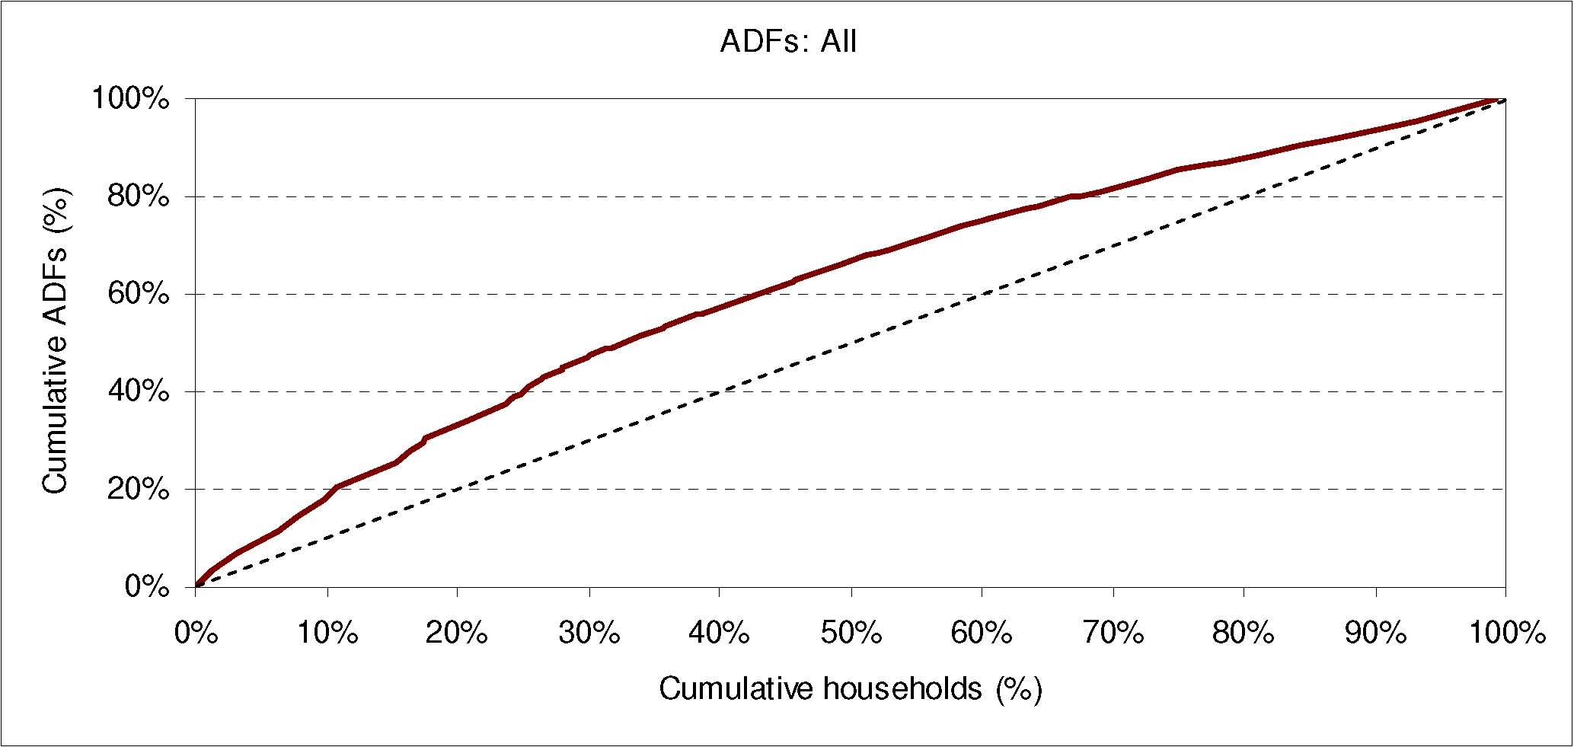
Notes:
Table 1. Hazard ratios of the effects of different Mosaic categories on the occurrence of ADFs
Table 1 presents estimation results for ADF incidence for the 6 most at risk groups with their Mosaic categories. We defined three models, one including all ADFs (Model 1) one including kitchen fires only (Model 2) and smoking-related fires only (Model 3). A hazard ratio above 1 indicates a covariate that is positively associated with the event probability, and thus negatively associated with the length of survival. Estimations were performed with Stata’s stcox and predict commands. See Appendix 1 for a detailed profile of each of the community groups and an explanation of the different categories.
Our findings suggest that households associated with the Mosaic groups above are prone to the occurrence of an accidental dwelling fire in their homes with the risk elevated for some groups when a fire occurs in the kitchen or is smoking related.

Slide 29
Targeting at-risk Groups to Reduce ADFs

Slide 30
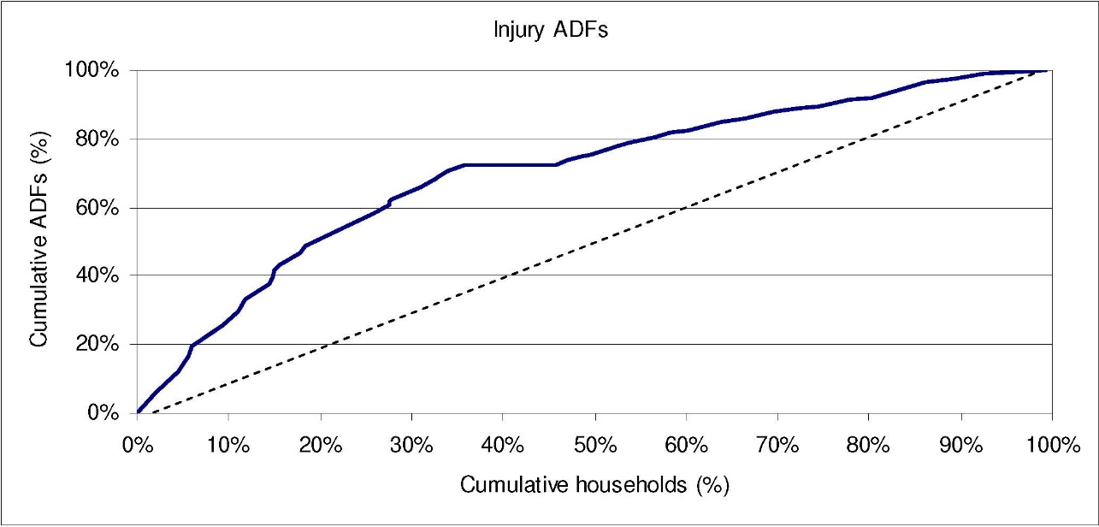
Targeting at-risk Groups to Reduce Injury ADFs

Slide 31
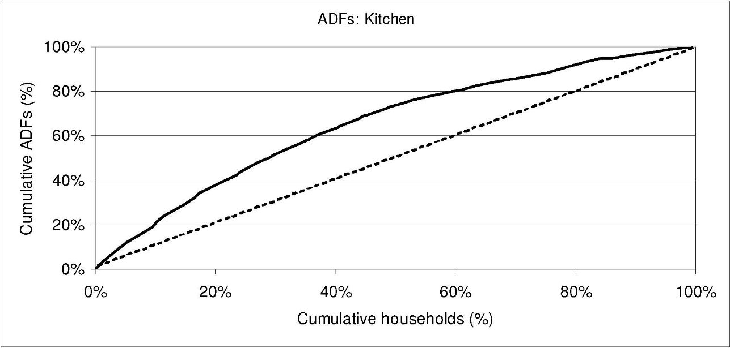
Targeting at-risk Groups to Reduce Kitchen ADFs

Slide 32
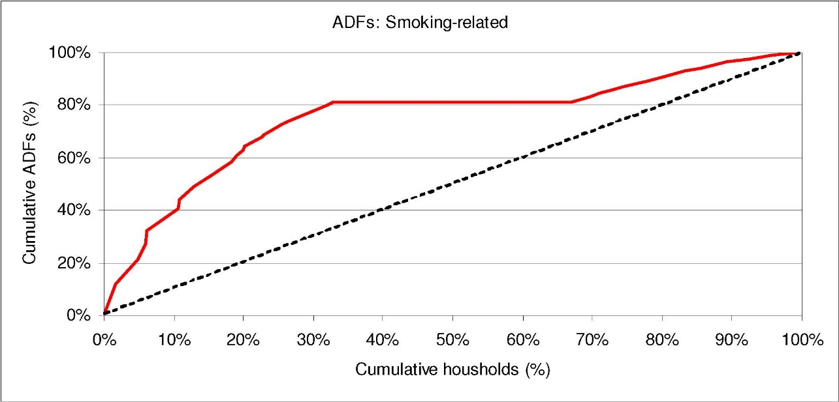
Targeting at-risk Groups to Reduce Smoking-Related ADFs

Slide 33
How each Group Prefers to Receive Information

Slide 34
Example Programme Evaluation:
Parish Safety Volunteers (PSV)
Pilot project, Essex County Fire and Rescue Services (ECFRS) & Essex Police (EP)
  Offsetting budget restrictions & organizational change by enlisting volunteers to deliver high quality emergency prevention support.
Volunteers
  Visited at-risk local homes and reviewed and informed households on fire and burglary safety
  Empowered to refer to other services
  Visit 240 homes in 10 months
Notes:
A pilot project, jointly run by Essex County Fire and Rescue Services (ECFRS) and Essex Police (EP)
Aimed at offsetting budget restrictions and organizational change by enlisting volunteers to deliver high quality emergency prevention support.
Volunteers
Recruited from the local community and trained jointly by fire and police services
Equipped with fire personnel attire and ID
visited at-risk local homes and reviewed and informed households on fire and burglary safety
(incl. installing smoke detectors, devising evacuation plans, and advising modifications to enhance personal and property security)
Empowered to refer to other services
WHY A GOOD TEST CASE?
* incorporates volunteers to perform emergency services related to prevention
Can examine program’s effects on outcomes while minimising bias from selection due to critical event occurrence
Administered according to the 3 recommended strategies we will be discussing later on
---
We examine the policy to shift particular emergency and crisis services from the public to the non-profit sector, studying a program in Essex County, United Kingdom.
The PSV Pilot demonstrates a local authority offsetting budget restrictions and organizational change by enlisting actors from the voluntary sector to deliver high quality emergency support.
In the Parish Safety Volunteers (PSV) Pilot Project, Essex County Fire and Rescue Services (ECFRS) employed volunteers to visit local homes and review fire and burglary safety.
In late 2015, Essex County Fire and Rescue Services (ECFRS) began the Parish Safety Volunteers Pilot Program. Parish Safety Volunteers was a joint pilot between the ECFRS and Essex Police (EP) Community Safety Departments, in collaboration with Local Authorities (ECFRS, 2014). The aim was to deliver a volunteer scheme in partnership with Local Authorities (LAs) across 36 parishes in Essex County, England, that would increase community safety and resilience and support objectives to strengthen communities (HM Government, 2012) by reducing their reliance on public services and funding.
Parish Safety Volunteers (PSVs) were recruited from the local community and trained jointly by ECFRS and EP to deliver home safety visits to at-risk properties. Participants were identified through a mixture of the volunteers’ local knowledge, LA parish council referrals, police referrals (following crime reports) and self-referral (ECFRS ran a major communications campaign offering residents the opportunity to request a home safety visit).
ECFRS recruited and trained volunteers to conduct safety visits, and equipped them with official clipboards, paperwork, and uniforms (hats and shirts) to wear during visits. During a visit, PSVs provided detailed information on all areas of home safety within the remit of the Fire Service and the Police, including installing smoke detectors, devising evacuation plans, and advising modifications to enhance personal and property security. PSVs received quarterly training and were empowered to refer other services. Overall PSVs delivered approximately 240 hours of home safety visits across 72 parishes in Essex over 12 months, beginning in March 2016.

Slide 35
Analysis
Difference-in-difference regression analysis
2 dimensions: time and treatment
4 comparison groups:
Estimation equation: y_{it}=b₀+b_{i}x_{i}+b₂z_{t}+b₃x_{i}z_{t}+e_{i}
(treatment, time) | Before 2016 | After 2016
treated | (1,0) | (1,1)
untreated | (0,0) | (0,1)
Notes:
We assess program impact by comparing the incidence of accidental dwelling fires (ADFs) in a difference-in-difference regression analysis. We offer results based on comparisons among groups on 2 central dimensions: time and treatment. Treatment is either treated (1) or untreated (0). Time is either before February 2016 (0) or after December 2016 (1). We thus end up with four groups: pre-2016 incidence among LAs that do not receive visits; post-2016 incidence among LAs that do not receive visits; pre-2016 incidence among LAs that will receive visits and post-2016 incidence among LAs that have received visits. Our estimation equation is:
$$y_{it}=b_{0}+b_{1}x_{i}+b_{2}z_{t}+b_{4}x_{i}z_{t}+e_{i}$$
Where for any LA i in month t, $y_{it}$ is the number of accidental dwelling fires, $x_{i}$ is 1 if treated and 0 if untreated, $z_{t}$ is 0 if pre-treatment and 1 if post-treatment, and $e_{i}$ is an error term. Each of these terms is interacted with each other to analyze conditional effects. Therefore: $b_{1}$ is the difference between treated and untreated groups before the PSV pilot; $b_{2}$is the difference between pre- and post-treatment measures among untreated LAs; and $b_{3}$ shows how the effect of being treated (v. control) changes as we change in time from pre- to post-treatment.

Slide 36
Results
Estimation results for ADF incidence.
Joint effects of treatment and time also given.
Notes:
Table 1 presents estimation results for ADF incidence. Because interaction effects can be difficult to interpret, at the bottom of the table are joint effects of treatment and time. Estimations were performed with Stata’s regression and lincom commands.

Slide 37
Notes:
The significant positive coefficient on PSV Treatment indicates that before the pilot program, the treatment group averaged .58 more ADFs per month than the control group. The insignificant coefficient on Time shows that the control group did not change in fire incidence from pre- to post- pilot. To interpret the remaining coefficients, we plot the marginal effects for each group in Figure 1.
The treatment and time effects become clearer when depicted visually. As the significant coefficient on treatment group indicates, prior to the PSV pilot the treatment group had more fires than the control group. After the PSV pilot, however, that difference is eliminated. This change is due to a decrease in fire incidence in PSV-treated locations from 5.73 pre-treatment to 4.92 post-treatment, for an average of 0.81 fewer ADFs per LA-month (4 fewer ADFs per treated LA per 5-month period).

Slide 38
PSV: Cost-Benefit Analysis
Fires decreased in PSV-treated locations by .81 per locality per month
  From 5.73 to 4.92
  4 fewer ADFs per 5-month period
Cost of ADF: £51,129 (Manchester New Economy Model)
Reduction in ADFs due to PSV: 51129*.81*65 = £2691941.85
Total benefit:
£2,691,941.85 - £77,544 = £2,614,397.85

Slide 39
PSV: Cost-Benefit Analysis
Fires decreased in PSV-treated locations by .81 per locality per month
  From 5.73 to 4.92
  4 fewer ADFs per 5-month period
Cost of ADF: £51,129 (Manchester New Economy Model)
Reduction in ADFs due to PSV: 51129*.81*65 = £2691941.85
Total benefit:
£2,691,941.85 - £77,544 = £2,614,397.85

Slide 40
PSV: Cost-Benefit Analysis
Fires decreased in PSV-treated locations by .81 per locality per month
  From 5.73 to 4.92
  4 fewer ADFs per 5-month period
Cost of ADF: £51,129 (Manchester New Economy Model)
Reduction in ADFs due to PSV: 51129*.81*65 = £2,691,941.85
Total benefit:
£2,691,941.85 - £77,544 = £2,614,397.85

Slide 41
PSV: Cost-Benefit Analysis
Fires decreased in PSV-treated locations by .81 per locality per month
  From 5.73 to 4.92
  4 fewer ADFs per 5-month period
Cost of ADF: £51,129 (Manchester New Economy Model)
Reduction in ADFs due to PSV: 51129*.81*65 = £2,691,941.85
Total benefit:
£2,691,941.85 - £77,544 = £2,614,397.85

Slide 42
PSV: Cost-Benefit Analysis
Fires decreased in PSV-treated locations by .81 per locality per month
  From 5.73 to 4.92
  4 fewer ADFs per 5-month period
Cost of ADF: £51,129 (Manchester New Economy Model)
Reduction in ADFs due to PSV: 51129*.81*65 = £2,691,941.85
Total benefit:
£2,691,941.85 - £77,544 = £2,614,397.85

Slide 43


Thank you !!!
Gina Yannitell Reinhardt, PhD: gina.reinhardt@essex.ac.uk
Kakia Chatsiou: achats@essex.ac.uk
Ruth Weir: rweir@essex.ac.uk
Jim Vine: jim.vine@essex.ac.uk
Dragana Vidovic: dvidov@essex.ac.uk
Jane Stanbury: jestan@essex.ac.uk
Bendik Andersen: bandera@essex.ac.uk
Alice Redknap: ar16991@essex.ac.uk
Alice Hutchins: ah18583@essex.ac.uk
Queal King: qk17214@essex.ac.uk
Adnan Pavel: ap18721@essex.ac.uk

